Slide 1
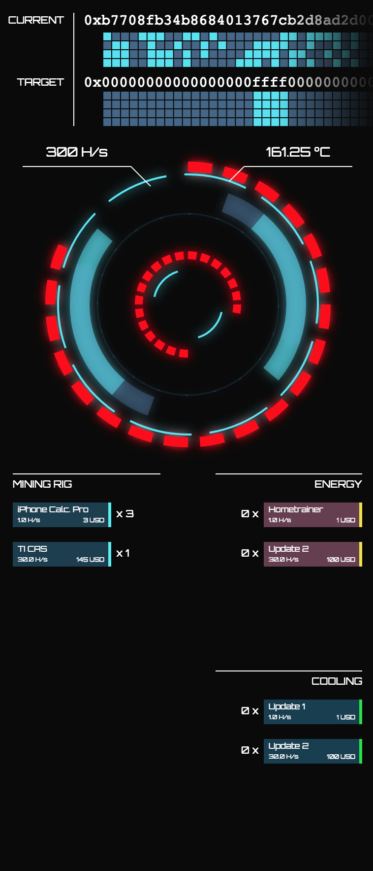
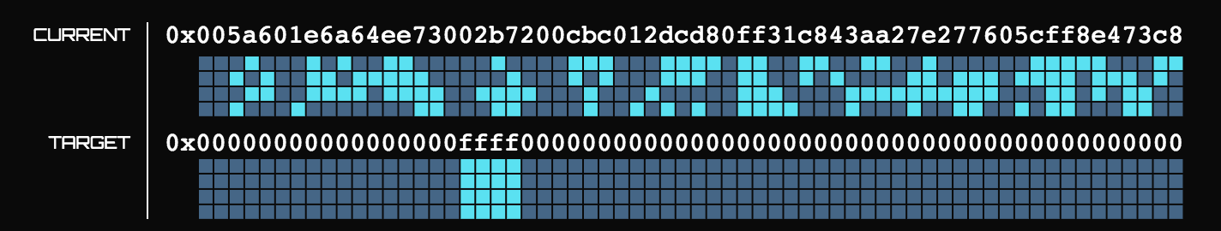
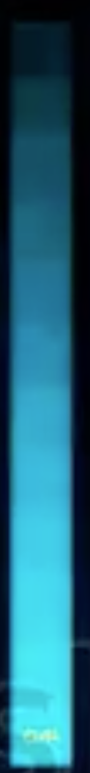
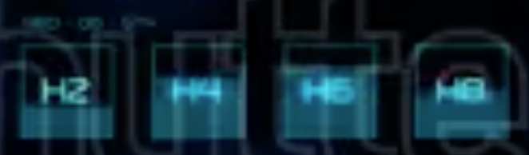
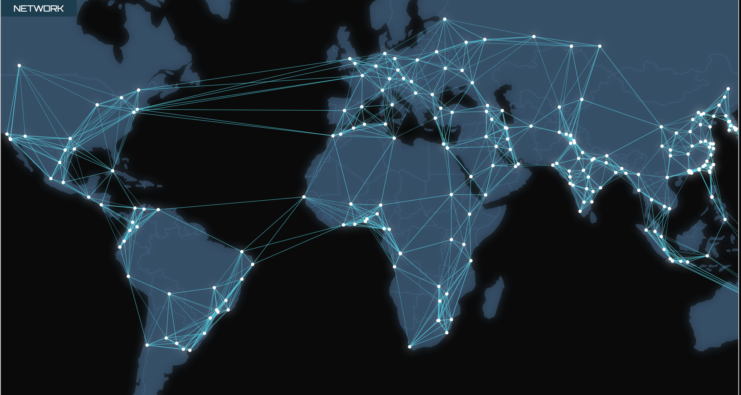
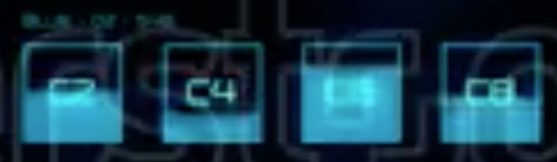
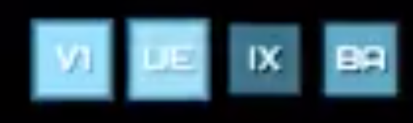
Wallet/Exchange
Blockchains
Coin Base
UTXO
Mempool
BlockCandidate
Version
Nonce
PreviousBlock
MerkleTree Root
Blue Nice
Upgrades
Bitcoin News:

Slide 2
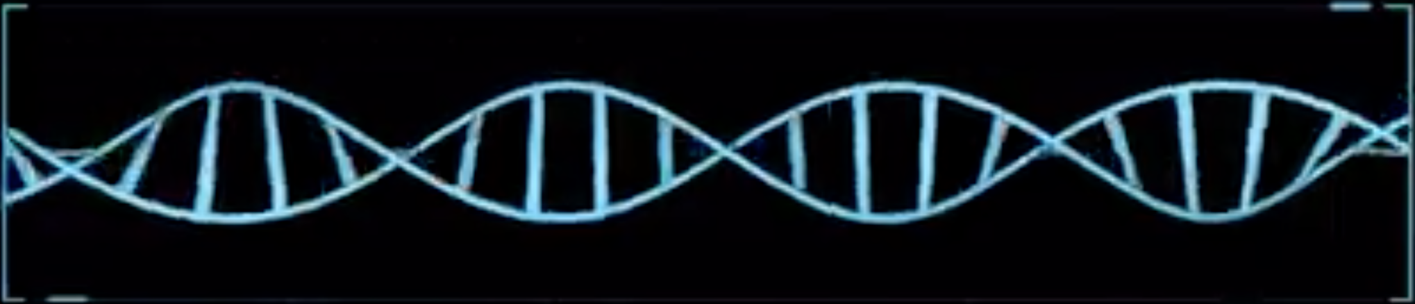
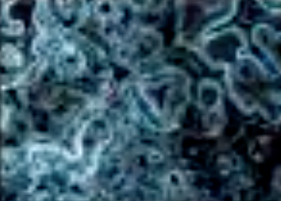
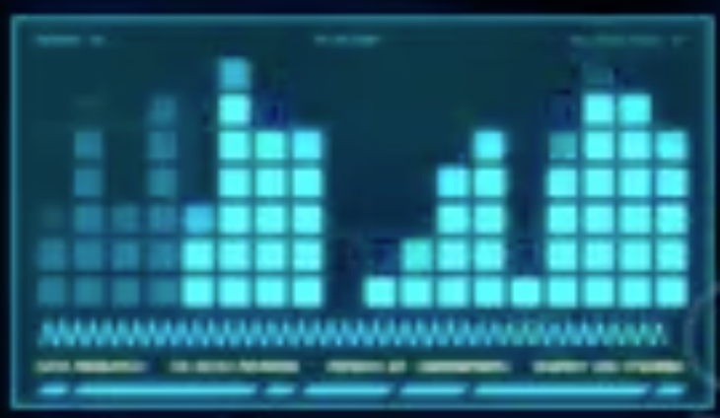

Wallet/Exchange
Blockchains
Coin Base
UTXO
Mempool
BlockCandidate
Version
Nonce
PreviousBlock
MerkleTree Root
Green
Cooperative
Upgrades
Bitcoin News:

Slide 3
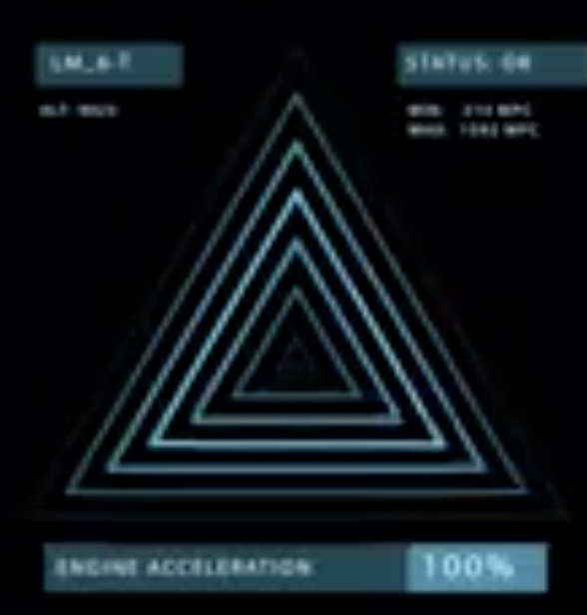
Wallet/Exchange
Blockchains
Coin Base
UTXO
Mempool
BlockCandidate
Version
Nonce
PreviousBlock
MerkleTree Root
Red
Kill Humans
Upgrades
Bitcoin News:

